Slide 1


Face recognition bAsed attendance system
Team members :-
Yash patil (19102a0039)
Omkar jalgaonkar (19102a0051)
Amey thorat (19102b0049)
Payas patel (20102b2007)

Slide 2

content
INTRODUCTION
PROPOSED SYSTEM
WORKING MODEL
FUTURE SCOPE
LITERATURE SURVEY
FLOW CHART
SOFTWARE AND LIBRARY USED

Slide 3

INTRODUCTION
As we are making a system which can recognize face and match with its own database. It will make the attendance system more authentic. Our primary goal is to help the lecturers, improve and organize the process of track and manage student attendance and absenteeism.

Slide 4
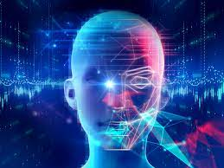
literature SURVEY
What is Face Detection ?
Face detection is the process of identifying and locating all the present faces in a single image or video regardless of their position, scale, orientation, age and expression. Furthermore, the detection should be irrespective of extraneous illumination conditions and the image and video content.

Slide 5
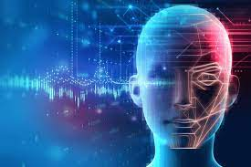
What is Face Recognition ?
Face Recognition is a visual pattern recognition problem, where the face, represented as a three dimensional object that is subject to varying illumination, pose and other factors, needs to be identified based on acquired images.
Face Recognition is therefore simply the task of identifying an already detected face as a known or unknown face and in more advanced cases telling exactly whose face it is.

Slide 6
Why is Face Recognition System Used ?
In this digital era, face recognition system plays a vital role in almost every sector.
Face recognition is one of the mostly used biometrics. It can be used for security, authentication, identification, and has got many more advantages.
Face recognition system can also be used for marking attendance in schools, colleges, offices, etc.
This system aims to build a class attendance system which uses the concept of face recognition as the existing manual attendance system is time consuming.

Slide 7

Proposed system
This project is based on attendance system in which attendance is recorded via Face Recognition.
In which first dataset is formed and then we will access that dataset and match the face detected in the given dataset and camera.
If the face is matching then it will display the name of given people in dataset or if face is not matching then it will display “Unknown” as an output on camera(webcam).
In the end, user will give email id on which attendance file will be sent.

Slide 8

FLOW CHART
Start And Run DataBase.py
Input Images via Folder
Camera is Started
Email is Sent
Face is Detected in Camera
Face is Recognized via file
Attendance is Record
Display the Result
Email is Received
Exit
CSV File is Made and Run Face detection.py
Face Detection in Images

Slide 9

SOFTWARE USED :
VISUAL STUDIO
PYTHON
CMAKE (For Face Recognition module)
PYTHON LIBRARY USED :
OpenCV
Face Recognition
Numpy
Pandas
Yagmail

Slide 10
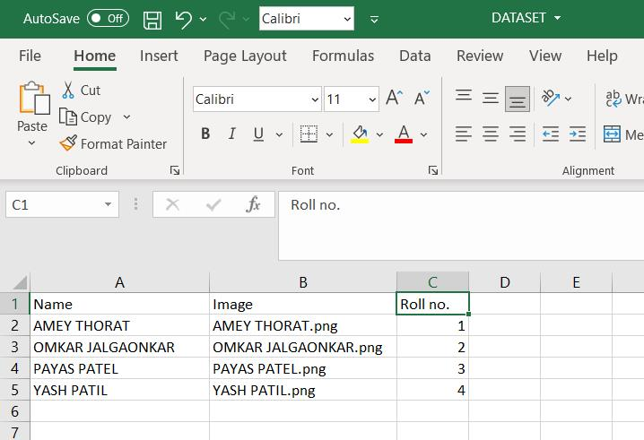
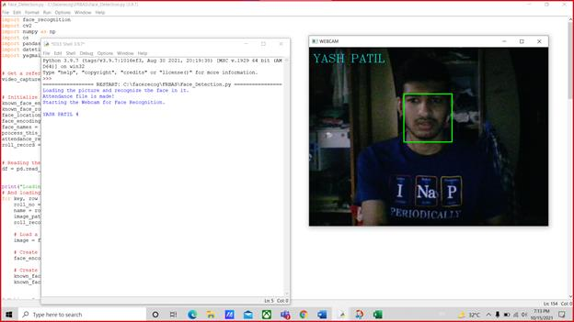
WORKING MODEL

Slide 11
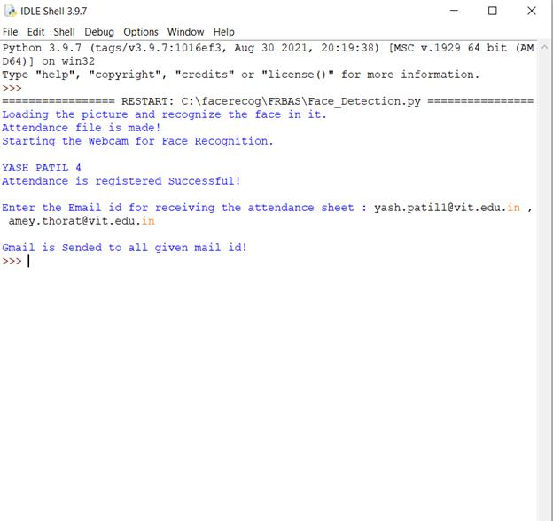
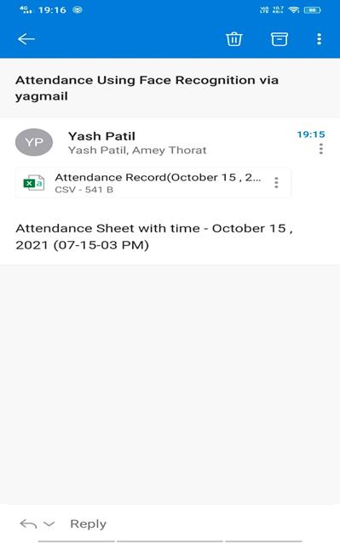
WORKING MODEL

Slide 12
FUTURE sCOPE
There are so many future scope on this project.
Some of them are
Can improve security
Can used in big factory or employee attendance
Can build on fully web based system
In future, we are going to make our project online
To get greater accuracy we need to use more powerful hardware and also need more resources

Slide 13




Thank You For your attention
Any questions ?

